Slide 1


Feasibility Study of Cargo shipping from Cochin port to its Hinterland and Minor ports in Kerala
KSCSTE- NATIONAL TRANSPORTATION PLANNING AND RESEARCH CENTRE
An Institution of Kerala State Council for Science, Technology and Environment
Mentor
Dr. Agnivesh P
Assistant Professor
Indian Institute of Technology (BHU), Varanasi
Study Team
Principal Investigator : Dr. Rameesha T V
Co-Principal Investigator : Dr. Goutham Sarang

Slide 2
OUTLINE
Introduction
Need for the study
Objectives & scope
Methodology
Data collection
Works to be done
Financial details
Task and Time schedule
References

Slide 3
INTRODUCTION
Waterways important in transportation of goods and people across the world
Coastal shipping - most economical, environment friendly and safe for domestic cargo.
India did not fully exploit potential of coastal shipping
Present domestic cargo scenario through inland/coastal shipping:
43% of in Europe
30% in China
14% in USA
7% in India

Slide 4
NEED FOR THE STUDY
Several researchers highlighted on the bottlenecks of coastal shipping development inside the country
One of the main reasons behind these bottlenecks may be the lack of demand prediction and proper economic analysis between different shipping modes which can enable in policy making and promote capital investment in coastal shipping
Even though Kerala has a coastal line of 590kms and waterway length of 1,687kms, scientific studies on coastal shipping and the possibility of integrating Inland Water Transport and coastal shipping is not reported much.
Kerala has all the geographical advantages for utilizing the waterway network especially for the feasible movement of freight traffic.
Shift of cargo movement from land to water is a need of the hour considering the increasing traffic congestion and crashes on the roads.
West Coast Canal flows parallel to the Arabian Sea with openings to the sea at several places, which makes the integration of coastal shipping and IWT viable.

Slide 5
OBJECTIVES AND SCOPE
Objectives
To assess quantum of inward and outward cargo from Cochin port to its hinterland and minor ports in Kerala.
To develop a model for predicting the freight traffic demand between Cochin port to its hinterland and minor ports
To integrate Inland Water Transport and coastal shipping for the transport of freight traffic through Cochin port to its hinterland and minor ports.
Scope
The study will investigate feasibility of coastal shipping of major cargo from Cochin port to its hinterland and important minor ports in Kerala
To assess the feasibility of integrating Inland Water Transport and coastal shipping.

Slide 6
METHODOLOGY
Literature Survey
Data Collection
Road/Rail Based
Freight Traffic Survey
Water based
Traffic demand modelling
Industry based
Feasibility of Coastal Shipping
Integration of Coastal Shipping and Inland water Transport
Inland Water Transport

Slide 7
Recap- Data Collection
Port Data
Port User Data
Annual data – 1952 to 2022
Annual volume for total freight, inbound and outbound freight
Commodity wise annual traffic volume in imports and exports from 2013-14 to 2022-2023
Collected from Cochin port
Daily data of foreign import and export from 2018 to 2022
On payment basis
From chamber of commerce
Comprises of Importer/exporter, port of loading, nation, shipping line, quantity and sail date

Slide 8
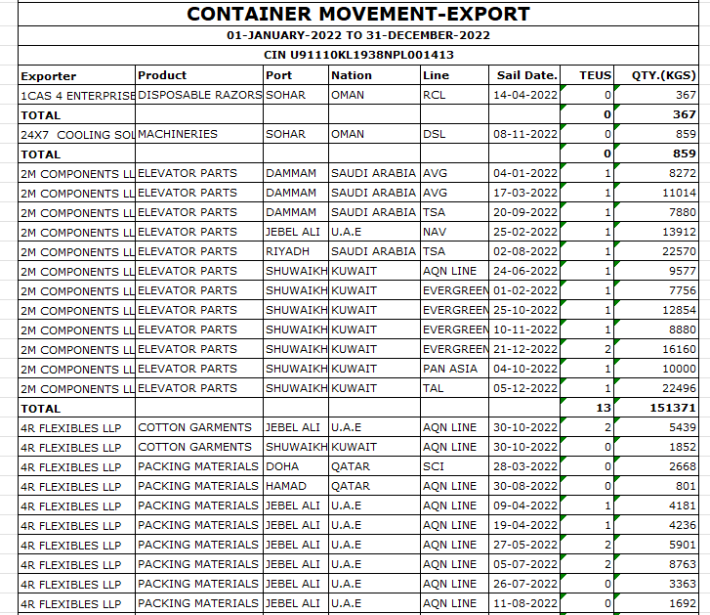
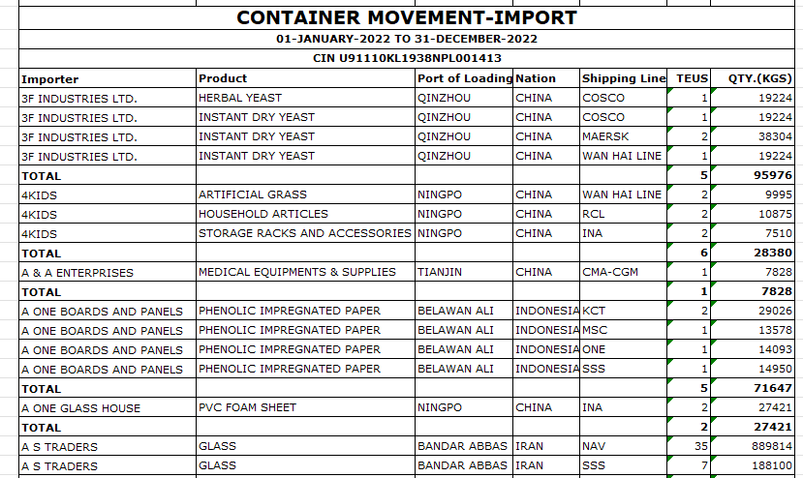
Foreign Traffic – Container movement
Total number of importers : 1721
Total number of exporters : 4627
Quantity above 1 lakh kg is sorted
Hinterland is identified based on the volume above 1 lakh kg
Total no. of importers :744
Total no. of exporters : 1195

Slide 9
Foreign Imports- Major commodities
District | Major commodities
Ernakulam | Equipments, machineries, PVC sheets, Steel doors, Veneers
Thrissur | Heat transfer paper, PVC panels, machinery and parts
Alappuzha | Frozen fish, ceramic balls, machinery parts
Kottayam | Calcium carbonate, PVC resign, steel doors, roof tiles, solar modules
Malappuram | Water proofing materials, pet food, spare parts veneers
District | Major Commodities
Palakkad | Washing machine, building materials, lime stone powders
Coimbatore | White cement clinker, tea, printing paper, raw cotton, HD polyethylene
Kannur | Veneers, PVC foam board, mattress, latex gloves
Kozhikode | Heavy melting scrap, tile glue powder, shoes, roof tiles, sunflower oil
Erode | Machinery and parts

Slide 10
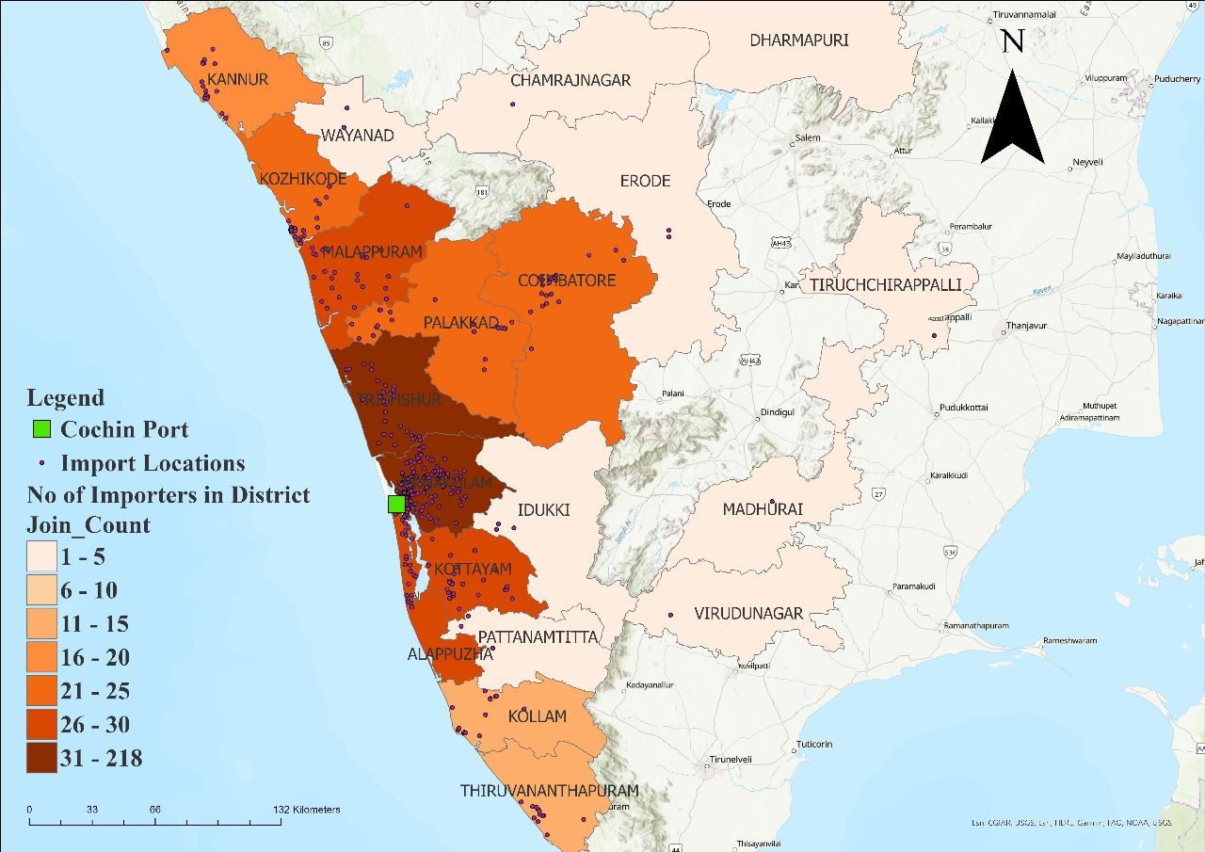
Hinterland based on number of importers
Major importer location is identified and mapped using GIS
Majority of importers are located in Ernakulam and Thrissur
Total No. of importers in Ernakulam – 214
Total No. of importers in Thrissur – 41
Other major importers are located in Kottayam, Alappuzha and Malappuram
Major importers are located outside Kerala mainly in Coimbatore

Slide 11
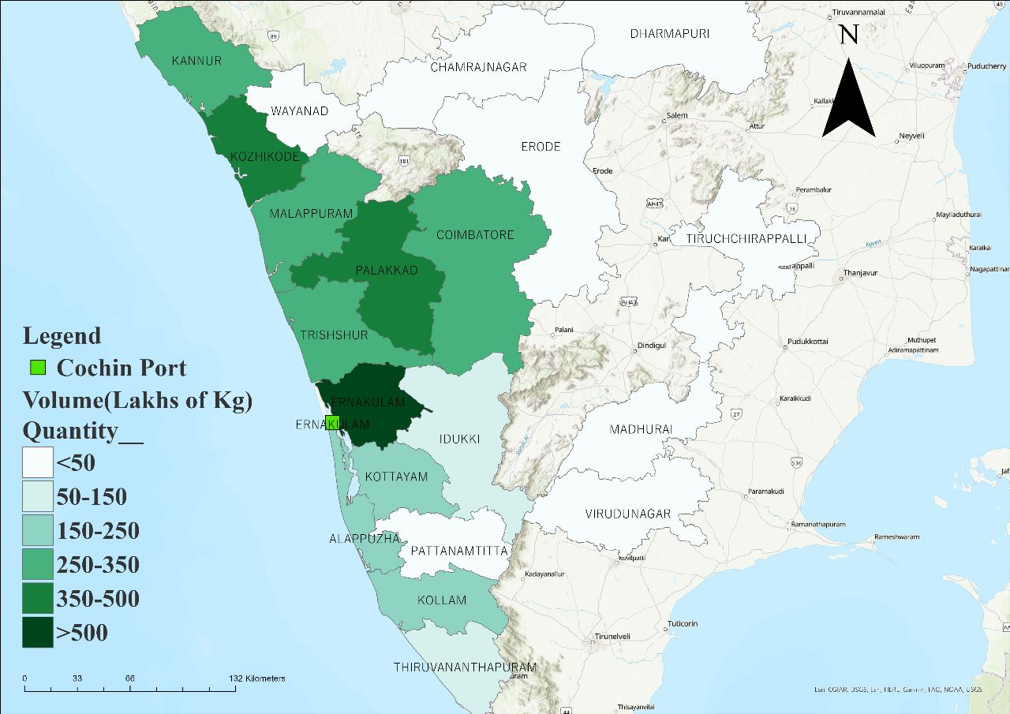
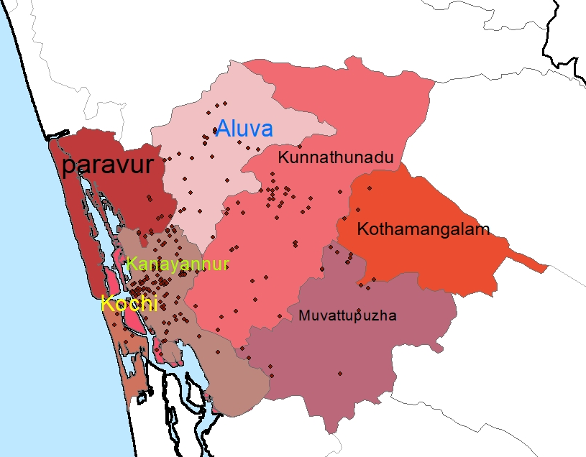
Hinterland identification based on volume of imports
Ernakulam
Total volume of foreign import in 2022 is 19482 lakhs kg
78% import volume- Ernakulam District

Slide 12
Foreign Exports- Major commodities
District | Major commodities
Ernakulam | Turmeric powder, Frozen squid, zinc concentrate, synthetic rutile
Kottayam | Rubber mats, tapioca chips, surgical gloves, coir mats
Alappuzha | Tender coconut, rubber mat, frozen fish, Rice
Kollam | Frozen squid, cashew
Thrissur | Spices, turmeric powder
Tirupur | Cotton yarn, Coir pith
Coimbatore | Instant coffee, valves, cotton yarn, coir pith, Tea
Idukki | Urad dal, Rice
District | Major commodities
Palakkad | Rubber thread, Fish oil, woven bags
Malappuram | Rice, rice powder
Kozhikode | Maida, coconuts, valves
Trivandrum | Clay, Blood bag, Frozen fish
Major Exporter
Cochin minerals and rutile limited –Synthetic rutile
Girnar Food and Beverages Ltd – Tea
William Good care & Son limited – Rubber mats

Slide 13
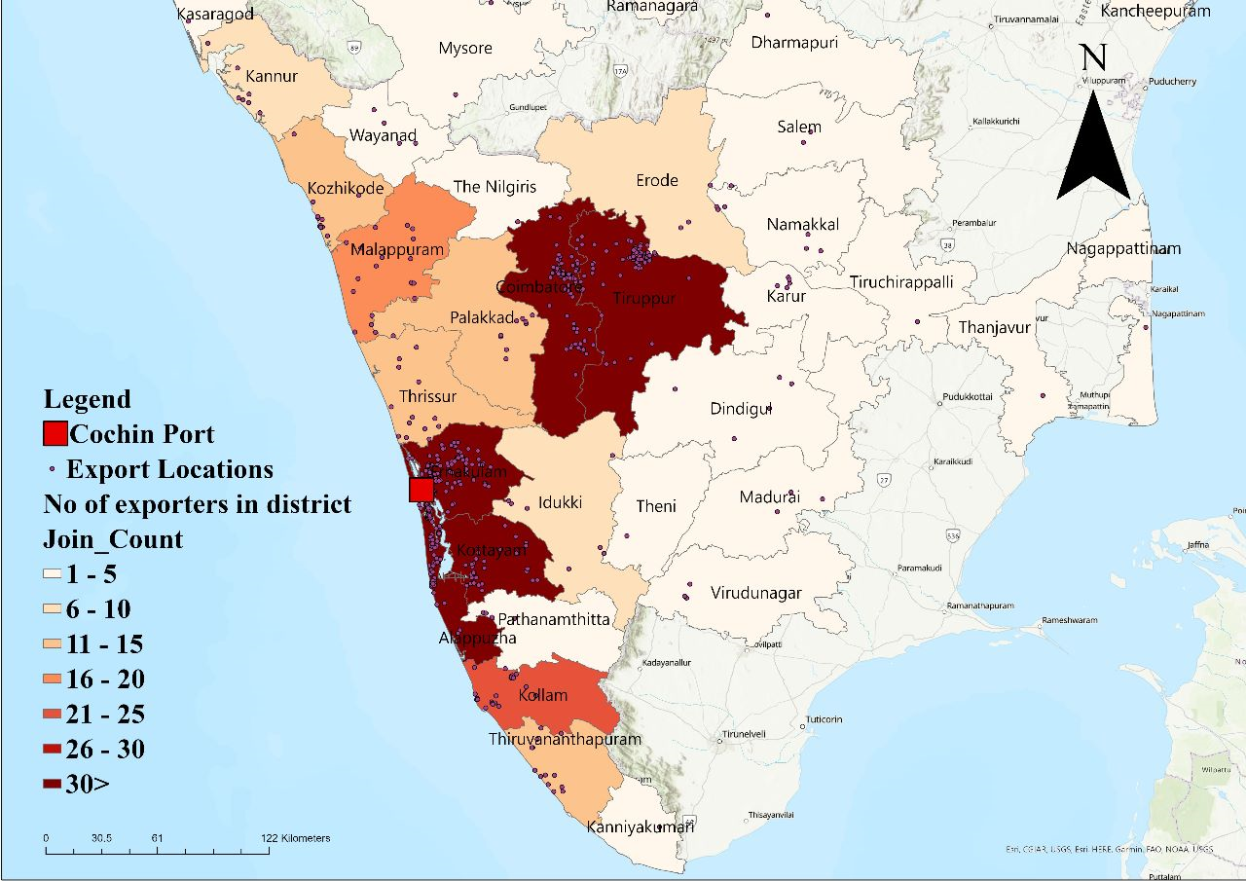
Hinterland Identification based on no. of exporters
Major exporter location is identified and mapped using GIS
Majority of exporters are located in Ernakulam, Thrissur, Coimbatore and Tirupur
Total No. of exporters in Ernakulam – 174
Total No. of exporters in Alappuzha – 101
Total No. exporters in Coimbatore – 78
Total volume of export is 14,590 lakhs kg
25% of total volume from Ernakulam

Slide 14
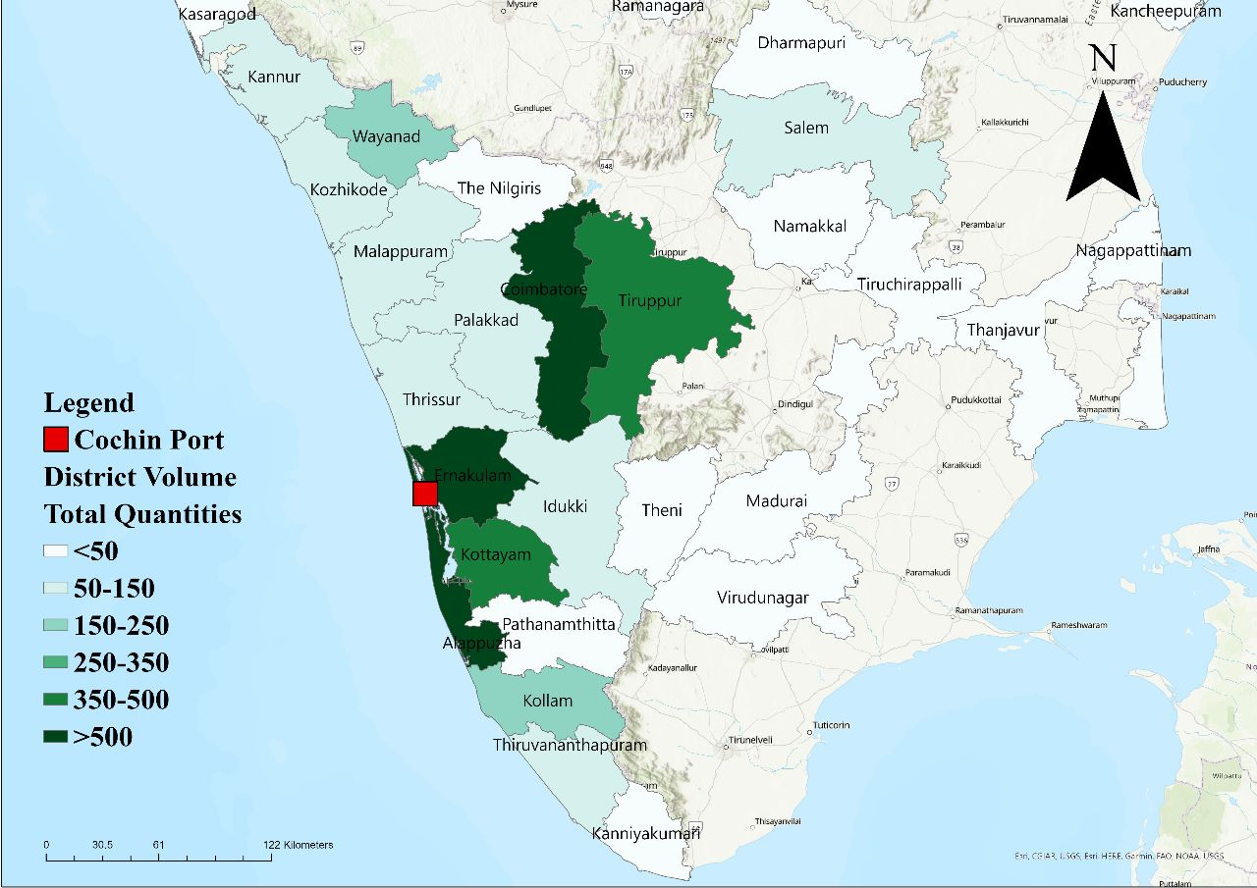
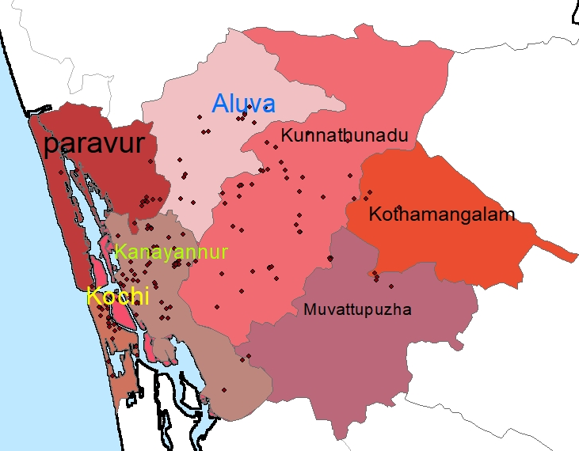
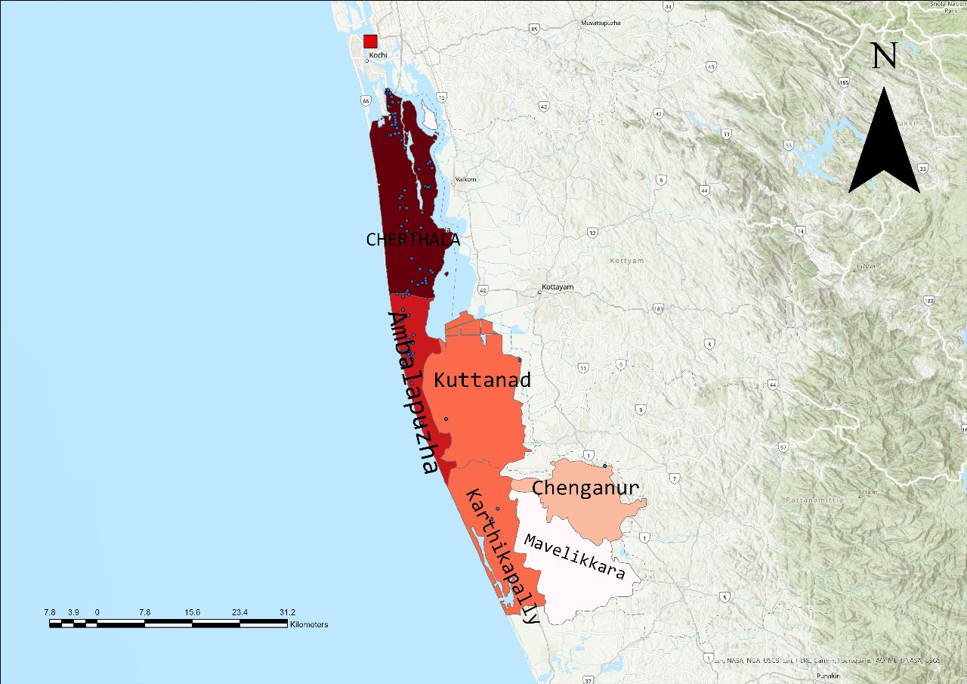
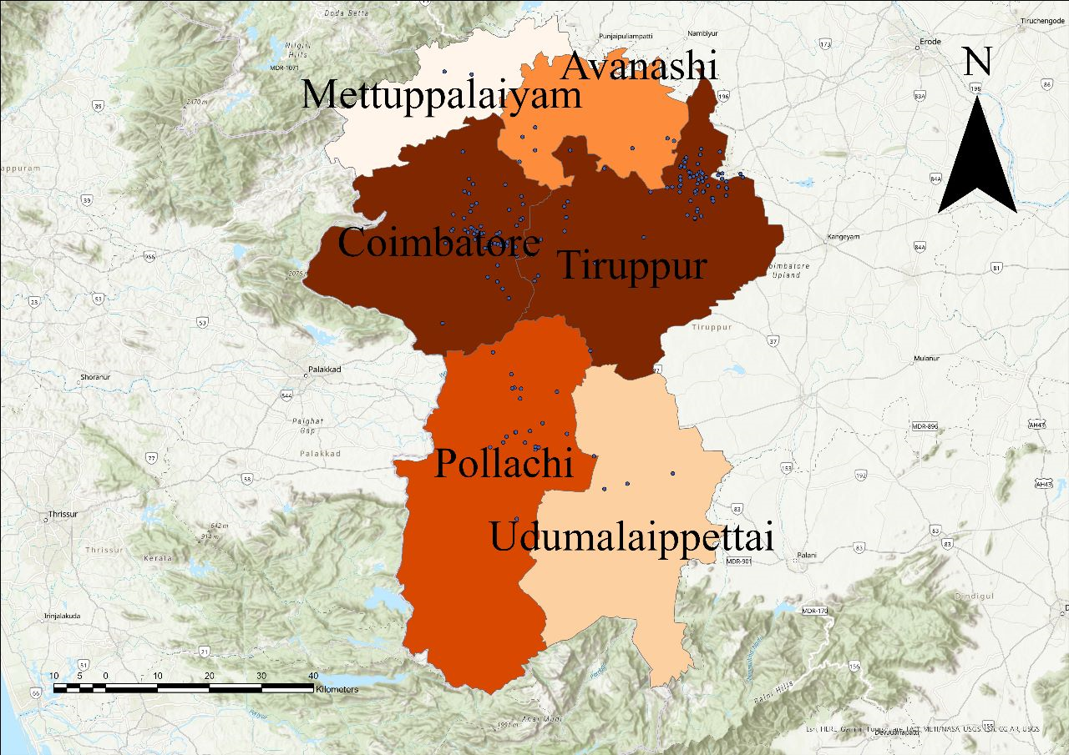
Hinterland Identification based on volume of exporters
Ernakulam
Alappuzha
Coimbatore

Slide 15
Major Hinterland of Cochin Port
Import | Export
Ernakulam – Kochi, Kanayannur, Kunnathunad, Aluva | Ernakulam – Kochi, Kanayannur, Kunnathunadu
Palakkad and Kozhikode – Based on volume | Alappuzha – Cherthala, Ambalppuzha
Thrissur, Malappuram and Kottayam – Based on number of importers | Coimbatore – Thiruppur, Pollachi, Coimbatore (N and S)

Slide 16
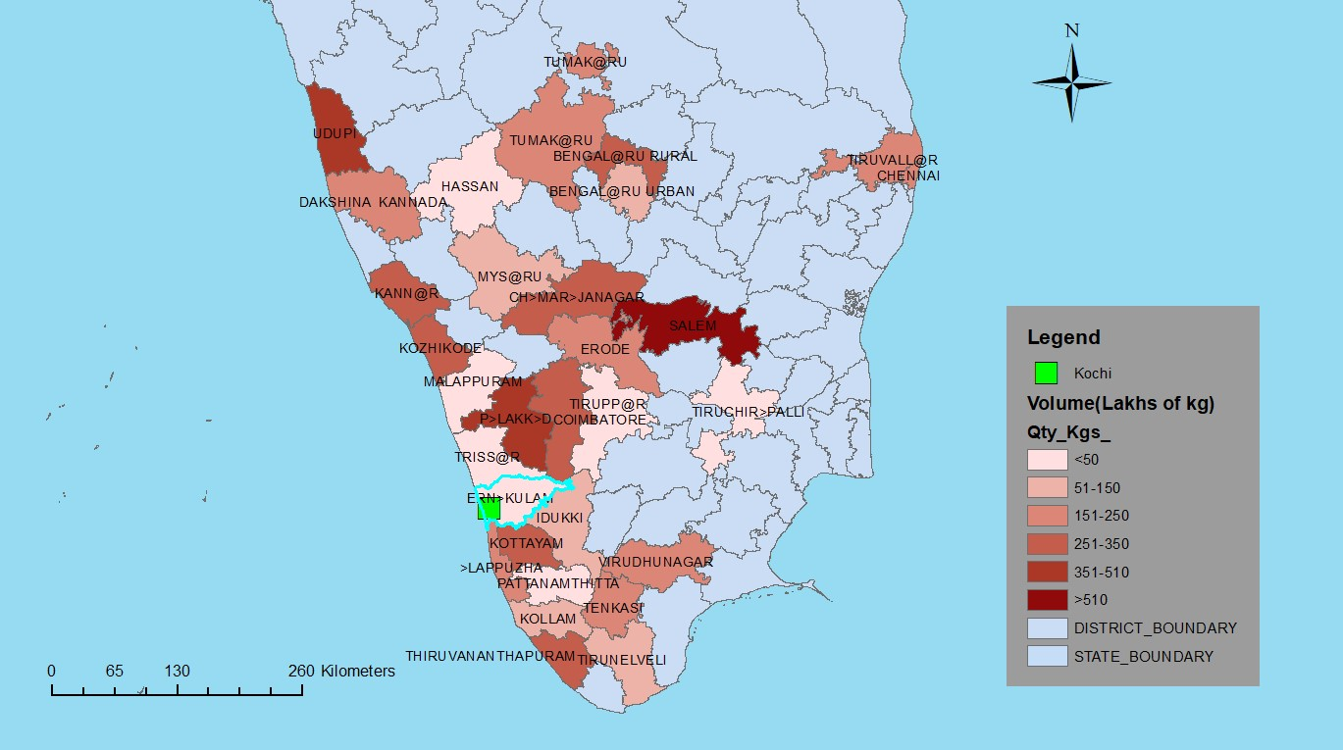
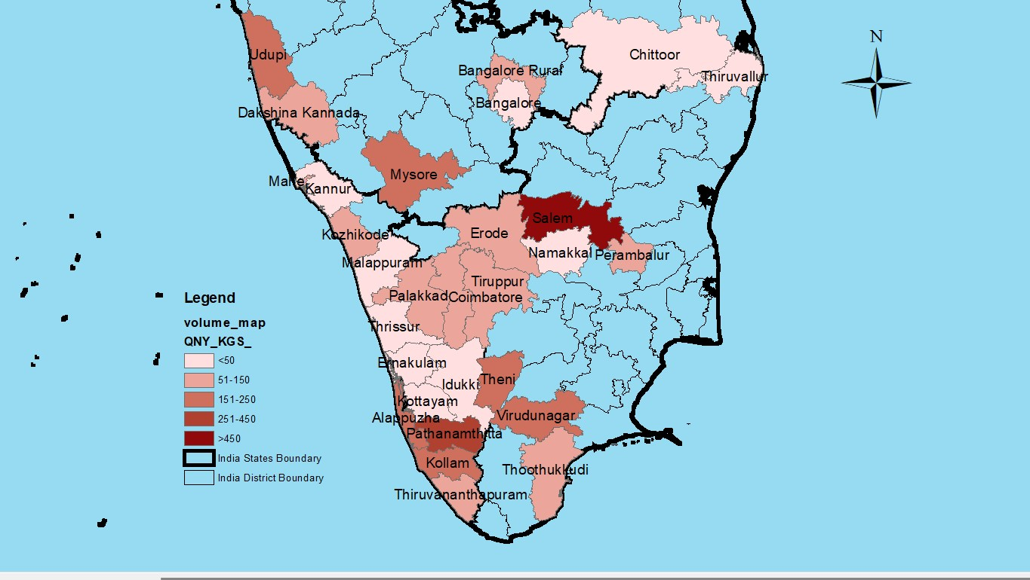
Year 2018
Year 2020
Hinterland based on Import
Year 2022

Slide 17
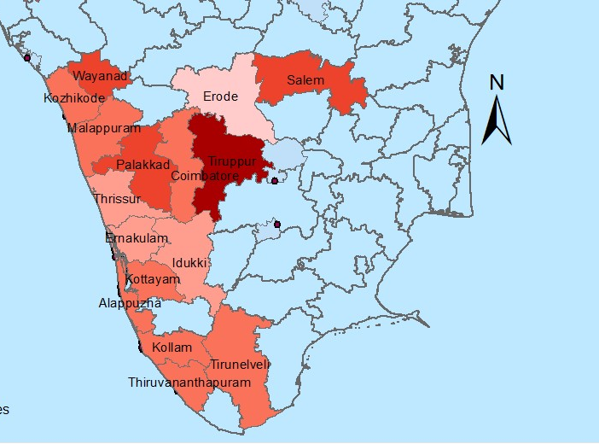
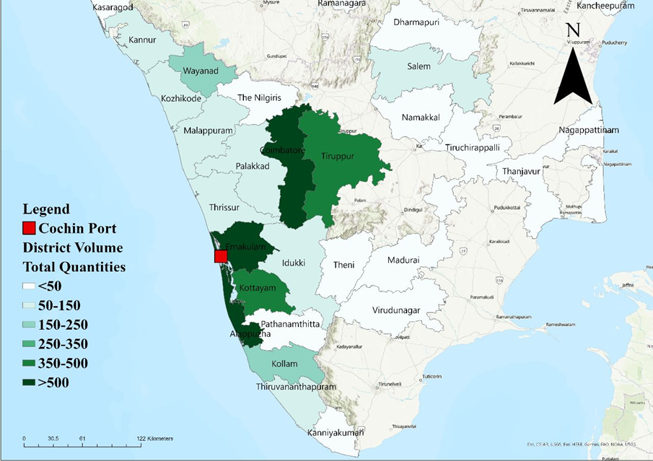
Hinterland based on export
Quantity in lakhs in kg
50-150
150-250
350-500
>500
Year 2018
Year 2022

Slide 18
Work done after last IRG Time series analysis
Time series visualisation of commodity wise traffic
Export and import volume from 2018 to 2022.

Slide 19
Commodity wise Analysis
Agro products
Tea, rice, cashew kernels
Export
Coir products
Coir mats, Coir fiber, Coir pith
Commodity volume
Rubber products
Rubber mat, Coir fiber, Coir pith
Marine food
Frozen marine foods, Frozen shrimps
Construction materials
Steel doors, elevator, cement
Import
Plastic products
PVC Ceiling, PVC flooring, PVC Resin
Medical Utilities
Medical materials and equipment, Medical disposables
Agro products
Apple, Rice, tea

Slide 20
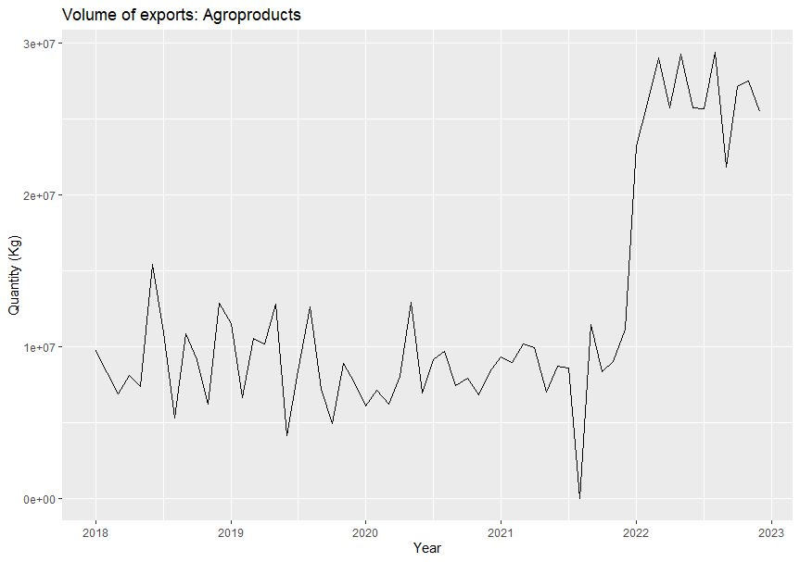
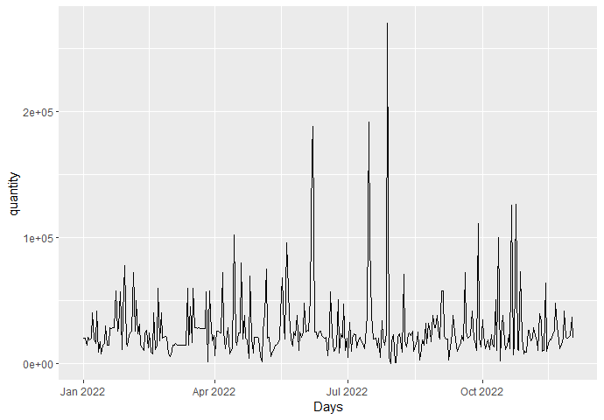
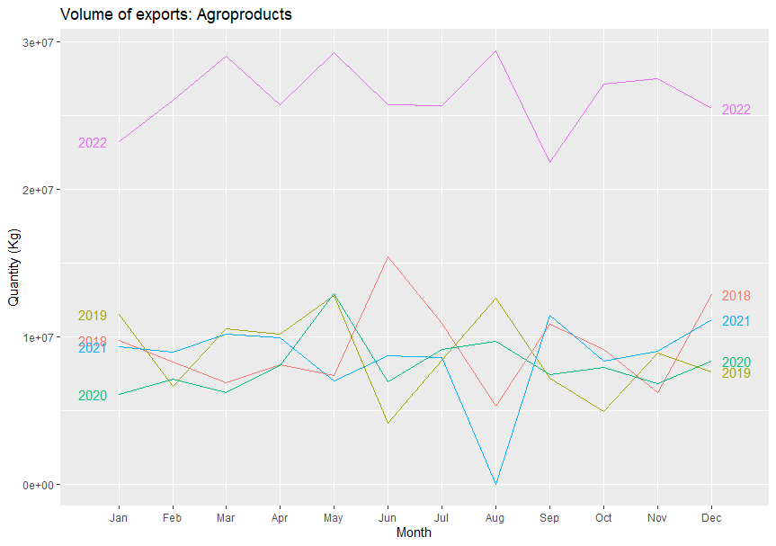
Export commodities - Agro-products

Slide 21
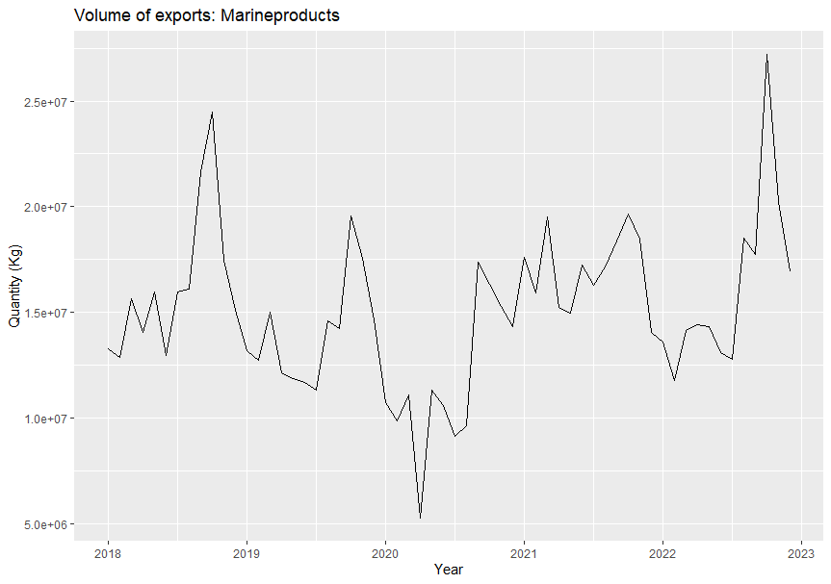
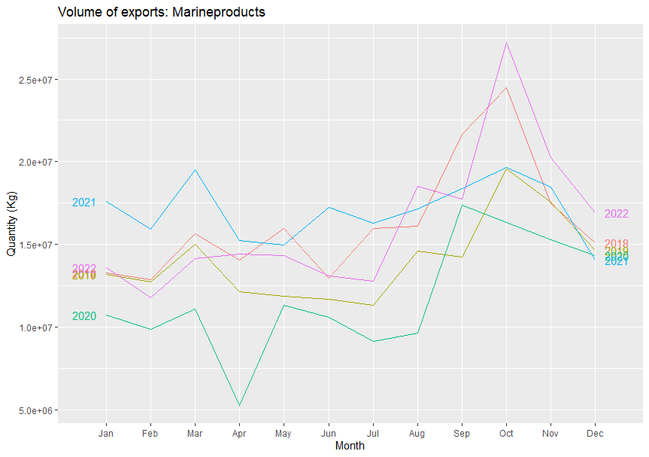
Export Commodities - Marine products

Slide 22
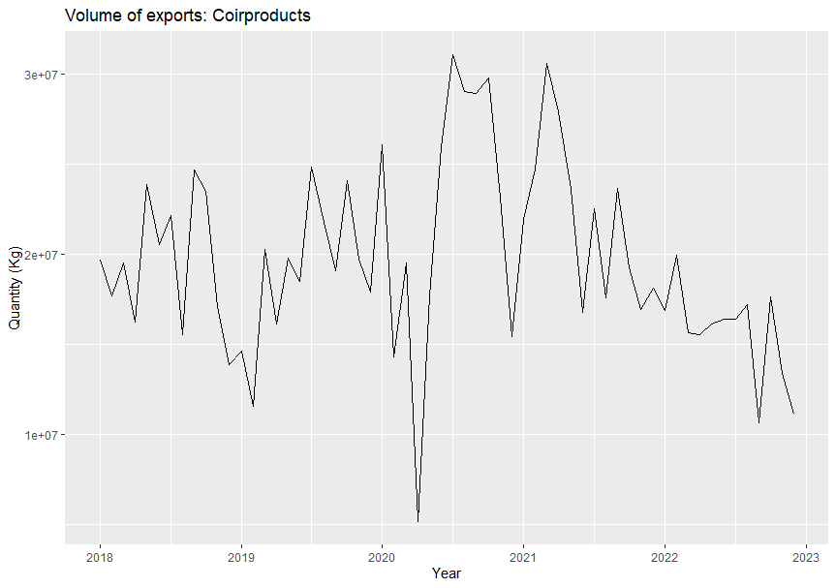
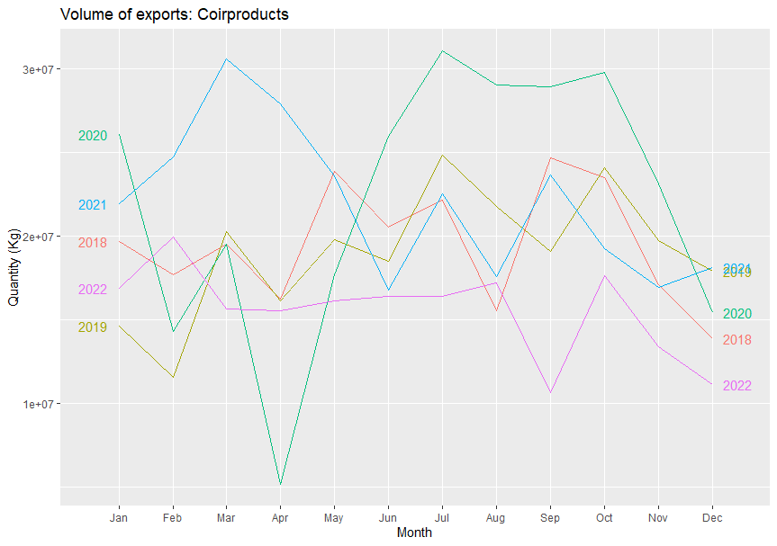
Export Commodities - Coir products

Slide 23
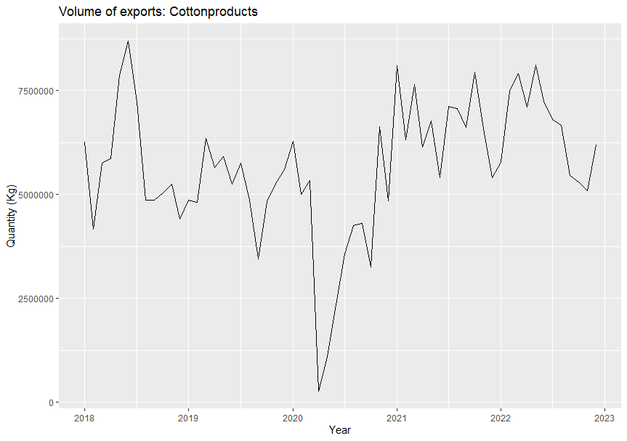
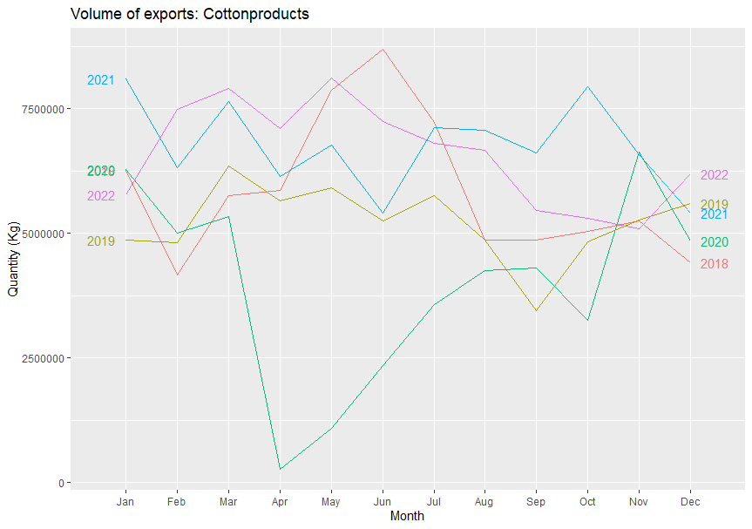
Export commodities- Cotton products

Slide 24
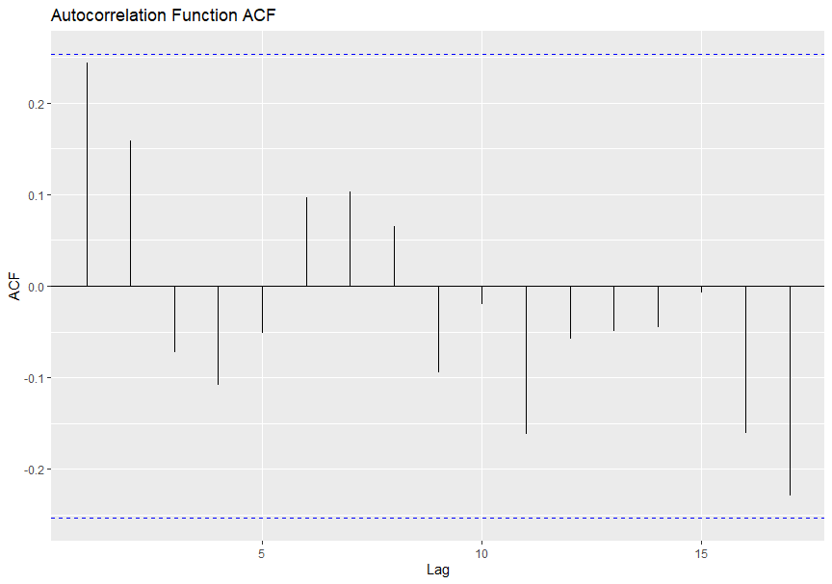
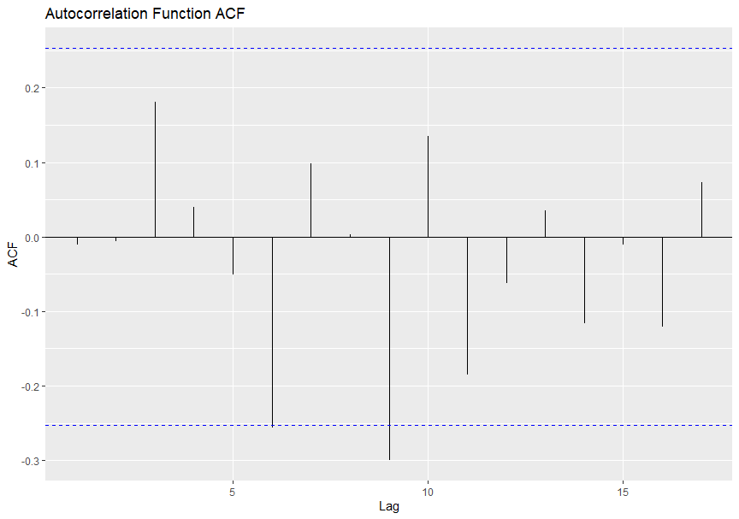
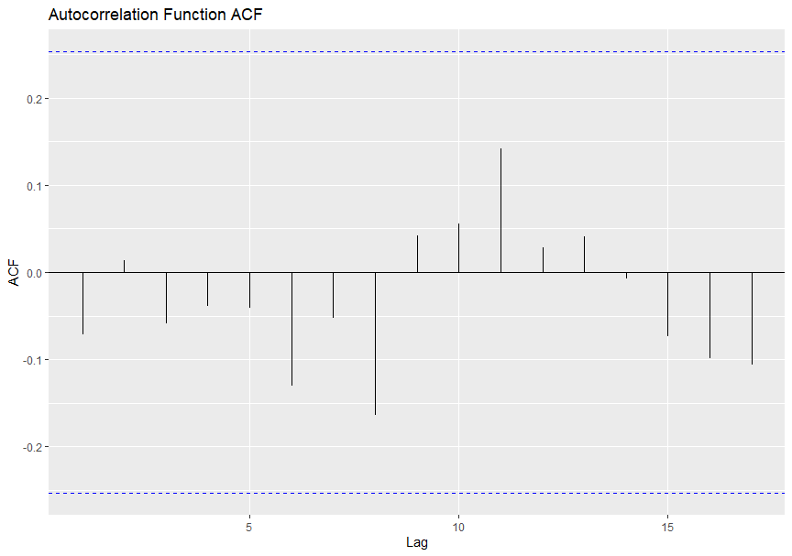
Auto correlation function
Coir products
Agro-products
Marine products

Slide 25
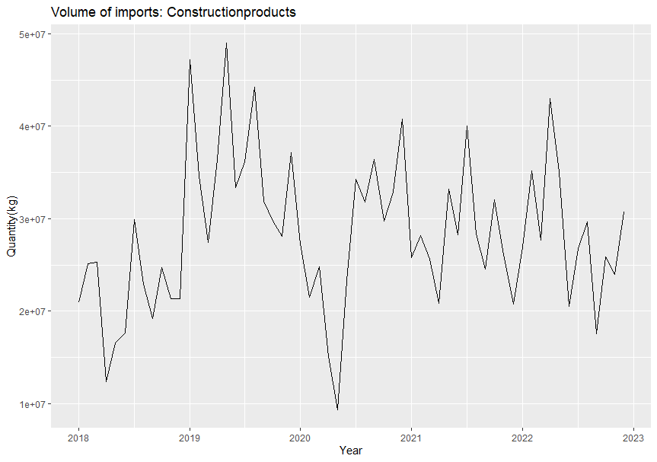
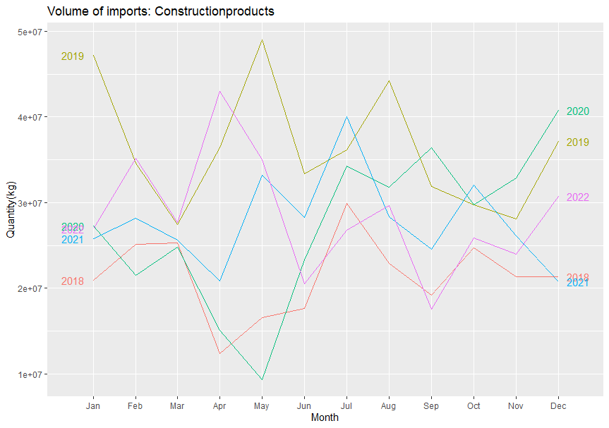
Import commodities- Construction materials

Slide 26
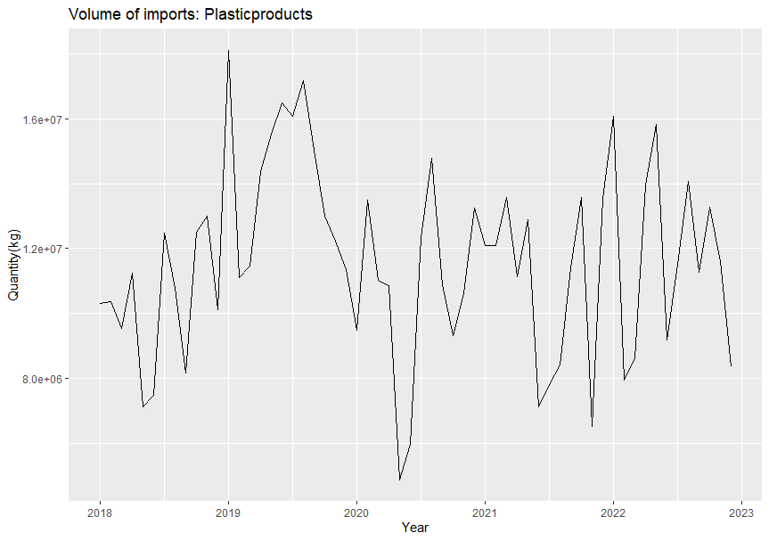
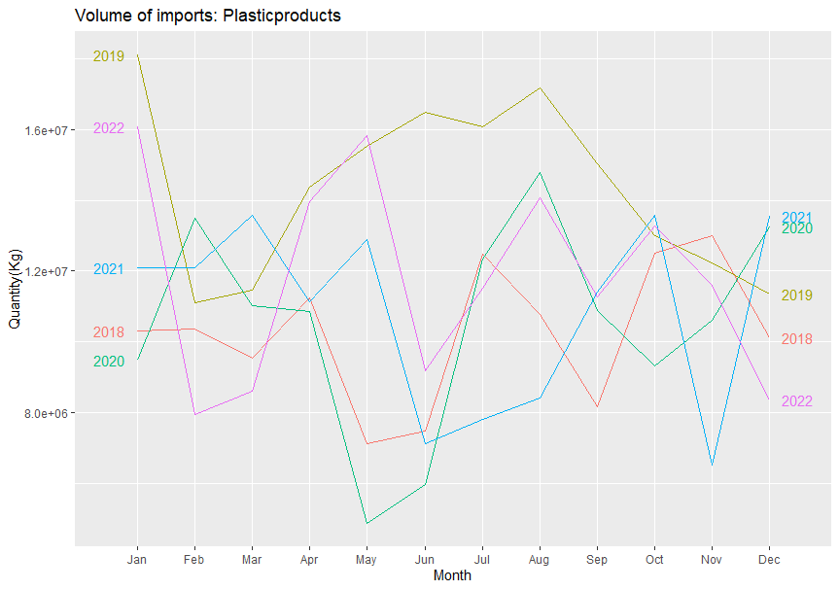
Import commodities- Plastic products

Slide 27
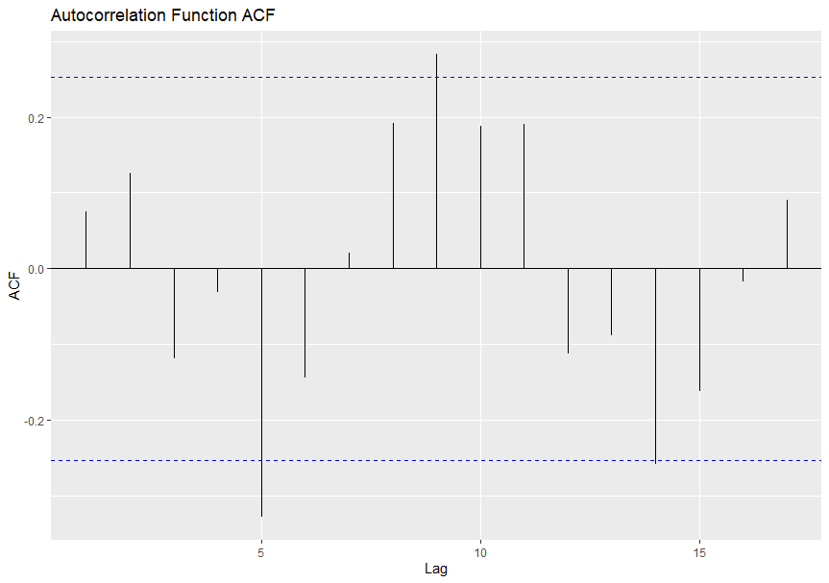
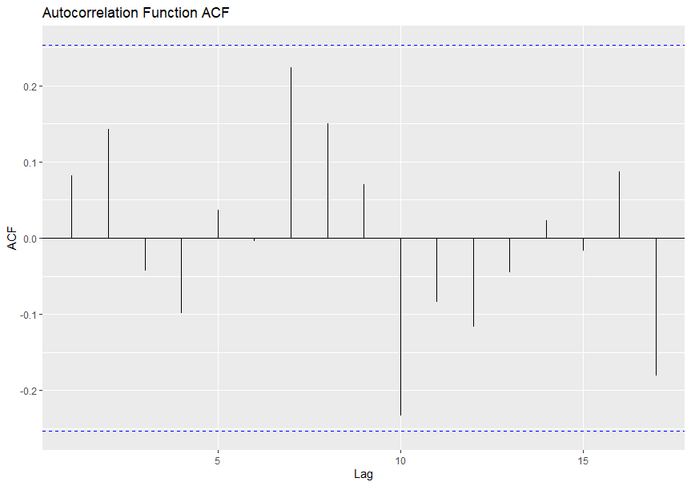
Auto correlation function
Construction materials
Plastic products

Slide 28
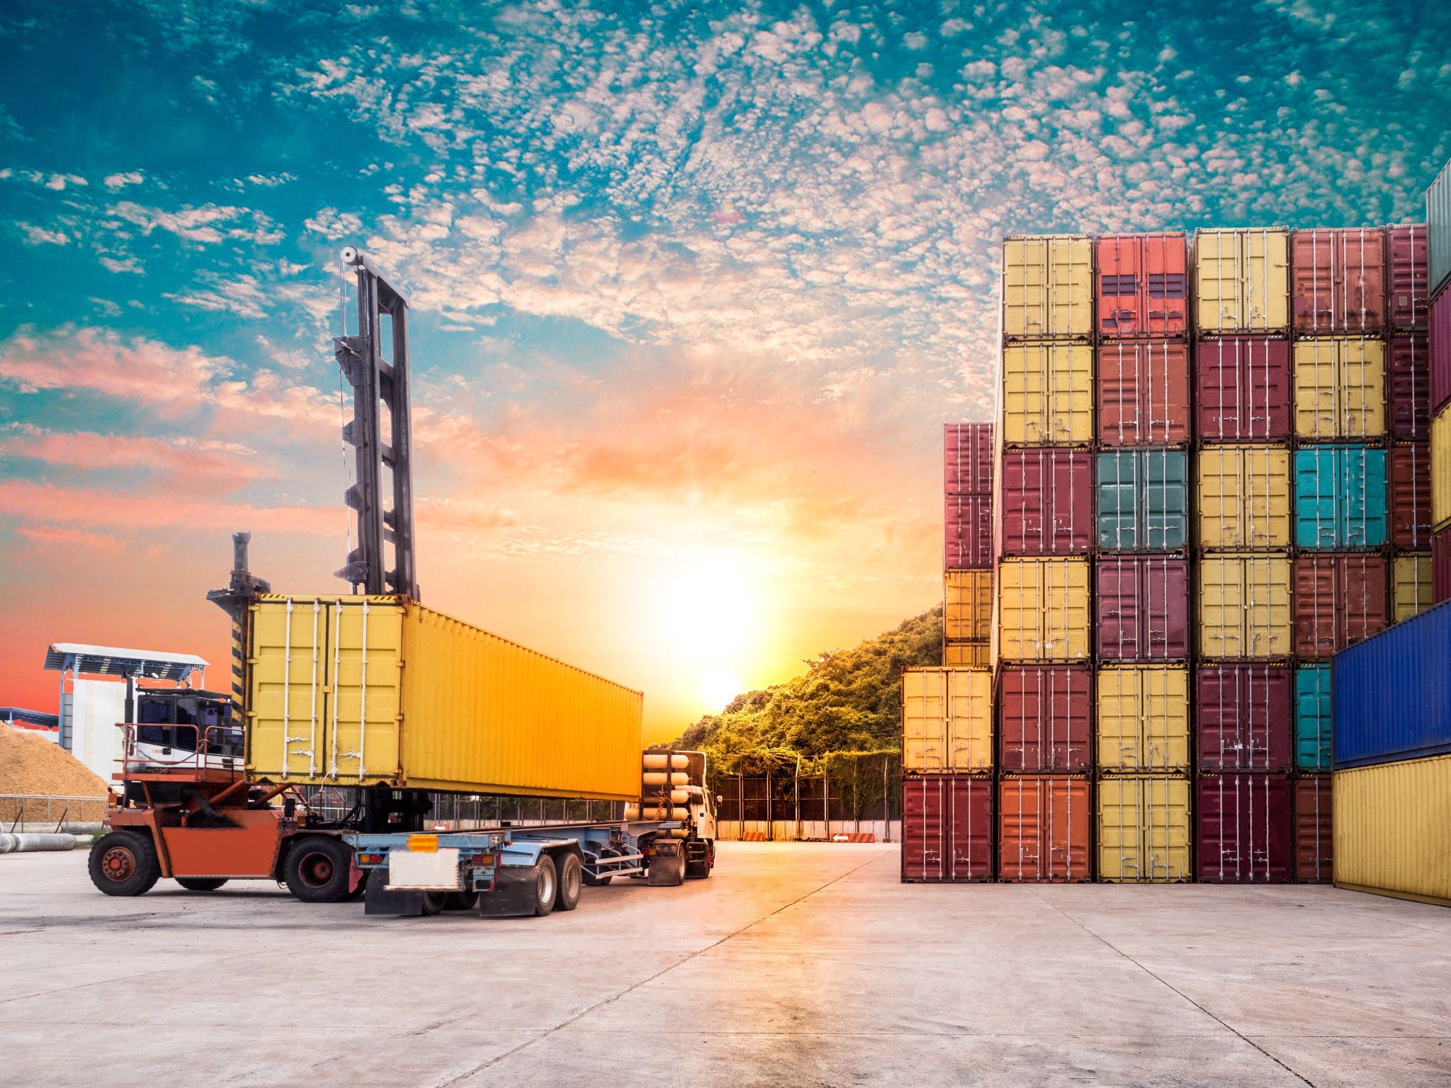
Analysis based on commodity and its Origin-Destination

Slide 29
Agro products
Tea, rice, cashew kernels
Export
Coir products
Coir mats, Coir fiber, Coir pith
Commodity volume
Rubber products
Rubber mat, Coir fiber, Coir pith
Marine food
Frozen marine foods, Frozen shrimps
Construction materials
Steel doors, elevator, cement
Import
Plastic products
PVC Ceiling, PVC flooring, PVC Resin
Medical Utilities
Medical materials and equipment. Medical disposables
Agro products
Apple, Rice, tea

Slide 30
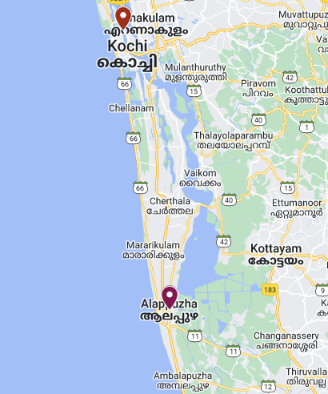
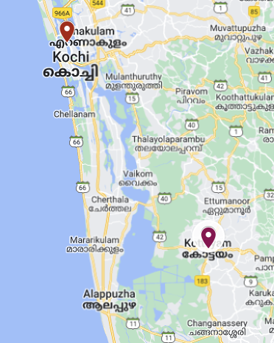
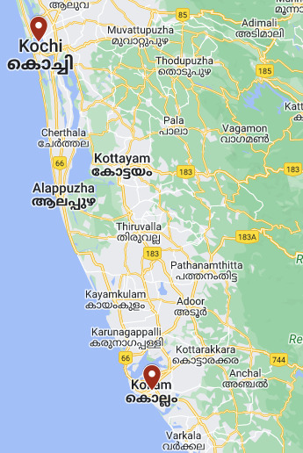

Cochin port
Cochin port
Cochin port
Kottayam
Alappuzha
Kollam

Slide 31
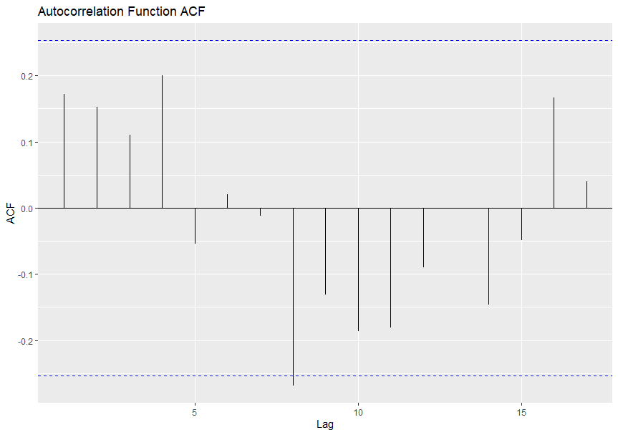
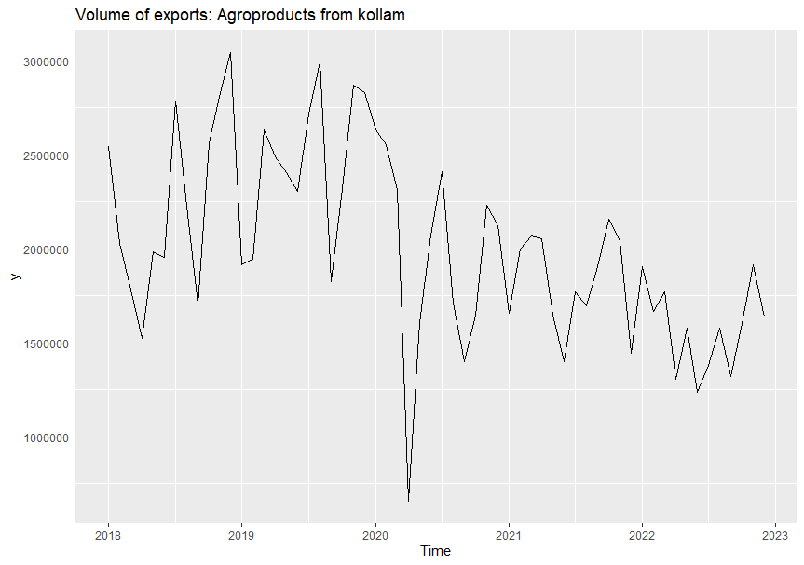
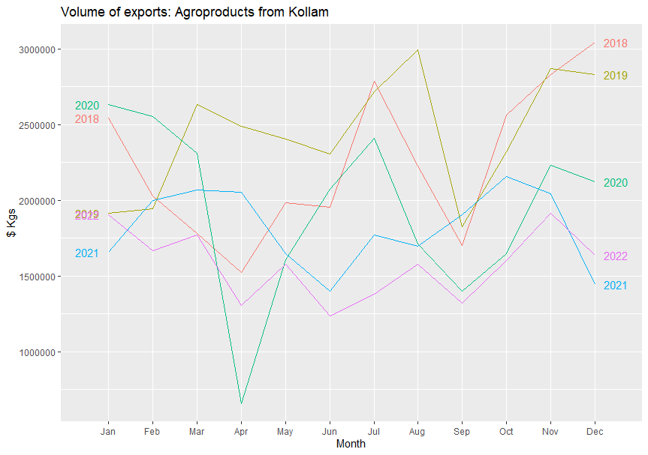

Slide 32
Traffic demand modelling
Possible explanatory variables variables (Based on literature)
Port related factors:
Port tariff
Terminal handling charges
Berth facility Terminal storage facility
Factors based on commodity:
Agricultural production rate
trolling period
Value density of commodity
Other factors based on commodity:
Population
Net District Domestic Product (NDDP)
Source : Liu and Park (2011), Patil and Sahu (2016), Gosasang et al. (2011), Seabrooke et al.(2003)

Slide 33
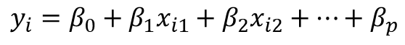
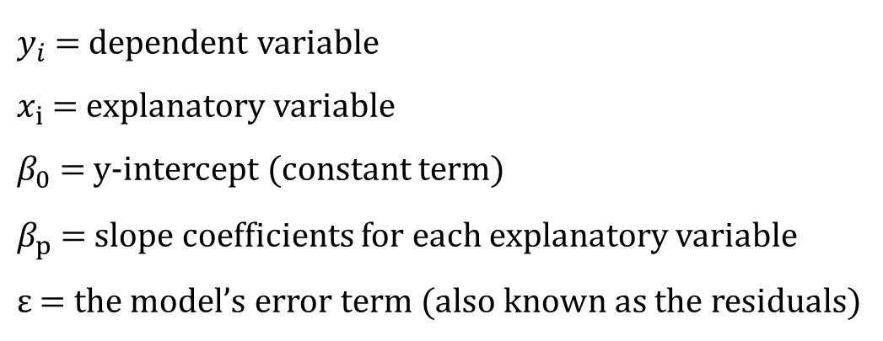
Regression Analysis
$$y_{i}=β_{0}+β_{1}x_{i1}+β_{2}x_{i2}+⋯+β_{p}$$
$y_{i}=β_{0}+β_{1}x_{1}+$ $β_{2}x_{2}+ … +$ $β_{p}x_{ip}+ ε$
$$where, for i=n observations$$
$y_{i}$ = dependent variable
$x_{i}$ = explanatory variable
$β_{0}$ = y-intercept (constant term)
$β_{p}$ = slope coefficients for each explanatory variable
$ε$ = the model’s error term (also known as the residuals)

Slide 34
Explanatory variables adopted in the present study
Export and import volume taken from 2003 to 2023
Explanatory variables
Population
Net District Domestic Product
Vessel related charges
Port dues
Pilotage fees
Tug charges
Shifting charges
Berth Hire charges

Slide 35
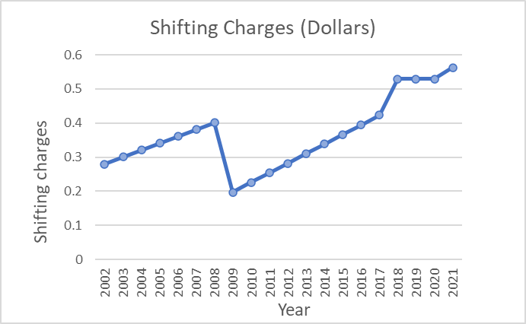
Vessel Related Charges
Vessel Related Charges

Slide 36
Correlation of variables
Model summary
Coefficient of determination, R² = 0.966
indicates that independent variables as a set, accounts for 96% of variance in export volume, R²>0
‘p’ value is 0.0, p<0.05 means that test is significant

Slide 37
Dependant variable | Predictors in the models | Excluded variables
Export volume | Population | Birth hire charges
 | NDDP | Shifting charges
 | Pilotage fees | Tug charges
 | Port dues

Slide 38
Works to be done
Traffic demand modelling – Time series method and Regression analysis
Feasibility of Integration of coastal shipping and Inland Water Transport

Slide 39
FINANCIAL DETAILS
Sl. No. | Components | Financial Targets (Lakhs)
1 | Field Survey, Data Collection | 2.7
2 | Data Analysis and Report Preparation | 1.5
3 | Miscellaneous and consumables | 0.8
Total |  | 5
10 % of fund has been utilized for data collection

Slide 40
TASK AND TIME SCHEDULE
Task | TIME SCHEDULE
 | 2022-2023 | 2023-2024
 | Jan-March | April -June | July-Sept | Oct-Dec | Jan- March
Literature Review
Data Collection
Demand Prediction
Route identification and analysis for integration of IWT and cargo shipping
Report preparation
Publications

Slide 41
REFERENCES
Seabrooke, W., Hui, E. C., Lam, W. H., & Wong, G. K. (2003). Forecasting cargo growth and regional role of the port of Hong Kong. Cities, 20(1), 51-64.
Tongzon, J. L. (2009). Port choice and freight forwarders. Transportation Research Part E: Logistics and Transportation Review, 45(1), 186-195.
Liu, L., & Park, G. K. (2011). Empirical analysis of influence factors to container throughput in Korea and China ports. The Asian Journal of Shipping and Logistics, 27(2), 279-303..
Rajamanickam, G. D., & Ramadurai, G. (2015) Simulation of truck congestion in Chennai port. In 2015 Winter Simulation Conference (WSC) (pp. 1904-1915). IEEE.
Patil, G. R., & Sahu, P. K. (2016) Estimation of freight demand at Mumbai Port using regression and time series models. KSCE Journal of Civil Engineering, 20(5), 2022-2032
Gosasang, V., Chandraprakaikul, W., & Kiattisin, S. (2011) A comparison of traditional and neural networks forecasting techniques for container throughput at Bangkok port. The Asian Journal of Shipping and Logistics, 27(3), 463-482.
Naumov, V. (2018). Modeling demand for freight forwarding services on the grounds of logistics portals data. Transportation Research Procedia, 30, 324-331.

